Slide 1
Technology, Risk and Gambling Seminar Series
“The impact of digital payment on gambling and potential for payment-based interventions”
Presenters –
Juliette Tobias-Webb, The University of Sydney
Sharon Collard, The University of Bristol
Moderated by
Sally Gainsbury and Kahlil Philander

Slide 2

Money And Gambling:
Practice, Insight, Evidence (MAGPIE)
Professor Sharon Collard
Personal Finance Research Centre, University of Bristol
Find out more:
magpie.blogs.bristol.ac.uk
Follow us:
@PFRC_UK
@SharonBCollard

Slide 3

The MAGPIE Programme
Builds on PFRC’s programme of work to help firms support customers in vulnerable situations
Focuses on the role of financial services in reducing gambling-related harm by helping create a safer environment
Delivers a series of projects over three years
Produces evidence-informed resources to minimise financial harm
Brings together/collaborate with a ‘coalition of the willing’

Slide 4
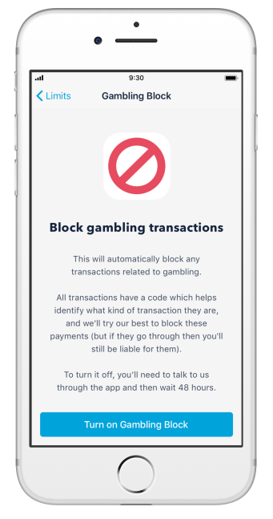
Priority 1: Gambling transaction blocks
Several banks and credit card firms have launched card controls to enable their customers to block spending on gambling…
But there’s limited evidence about ‘what works’ and who for
Our aim: produce an evidence-based standard for card controls that balances commercial realism with consumer-centred friction and intervention.

Slide 5
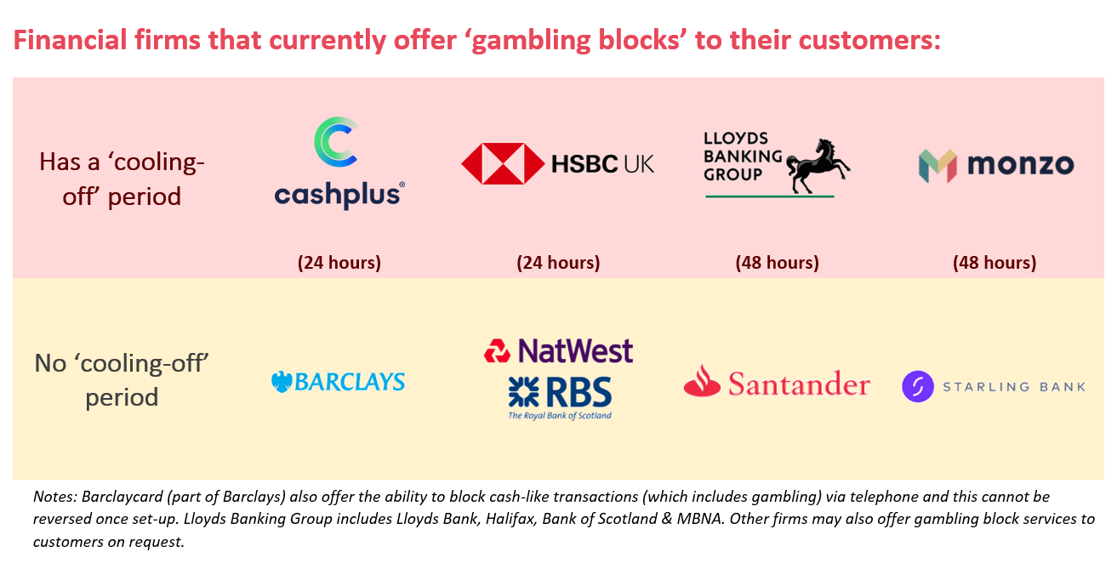
Priority 1: Gambling transaction blocks

Slide 6
Complexity of Design
Stakeholders: Individual customers, operators, regulators (legal sticking points)
Many product teams (Debit, Credit, Responsible lending)
Costs of design
Customer choice
Risk concerns (i.e. responsible lending)
Mental health = “grey area”.
Spectrum of harm
Subjective nature of defining gambling and problem gambling
Visibility of machine gambling
Type of intervention: Digital – messages, phone services, blocks etc. (Not a huge amount of evidence here)
Outcome measures and metrics to test the effects
Notes:
-Banks, Commercial, Customer, Legal, Regulatory
-Financial information – problems here with subjective nature (although clear indices). Data – but what to look for – and how can we check?
-Debit vs Credit vs Ongoing Risk
-Spectrum of Harm: Prevention, Treatment etc. …
-Features: Digital messages (awareness, prevention,), services when reporting, blocks – Monzo,
-Legal – if someone gives you information, store. Rights for accessing your own money
-Customer choice
-Gaps –
-Grey areas – where does the line stop. What is gambling? Can we even see gambling spend? Reporting problems and future restrictions – responsible lending
-Emerging areas –
-Cost (Even a button costs millions of $)

Slide 7
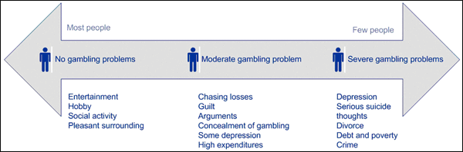
Spectrum of Gambling Harm
Prevention
Intervention
Awareness
SA Government, 2018
Notes:
Behavioural scientists love to save the world.
Harm is rising – not just at the high end
Harm associated with gambling lies along a spectrum of risk, with suck risks including inreased investment of time and money spent gambling, a preoccupation with gambling and gambling losses, and continued gambling depsite negative personal, financial and familiate outcomes
PG is also estimated to cost society up to AUD$7BILLION AND THE uk GOVERNMENT IS ESTABLISHED TO SPEND £1.2 BILLION PER ANNUM ON GAMBLING-RELATED SOCIAL COSTS.
Thus developments and
https://problemgambling.sa.gov.au/gamblers/what-is-problem-gambling

Slide 8
Resources
Sharon Collard
Our programme of work on supporting customers in vulnerable situations, including reports: http://www.bris.ac.uk/geography/research/pfrc/themes/vulnerability/
More info on the MAGPIE programme with GambleAware: https://magpie.blogs.bristol.ac.uk/

