Slide 1
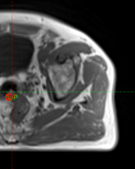

EVALUATION OF A COMMERCIAL AI BASED SOFTWARE FOR SYNTHETIC CT IMAGE GENERATION
Dr Laura O’Connor
Consultant Radiation Therapist
Calvary Mater Hospital, Newcastle

Slide 2
PURPOSE & METHODS
AI based sCT has been shown to be highly accurate in previous studies
Investigate commercially available AI based sCT
Application to pelvis and brain
  40 pelvis (20 prostate, 20 greater pelvis {10m, 10f})
  8 brain (7 primary brain, 1 metastatic)

Slide 3
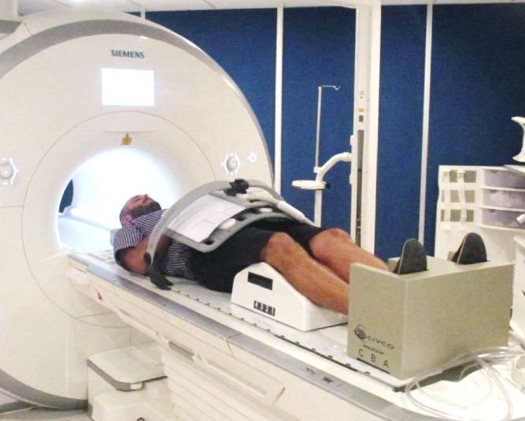
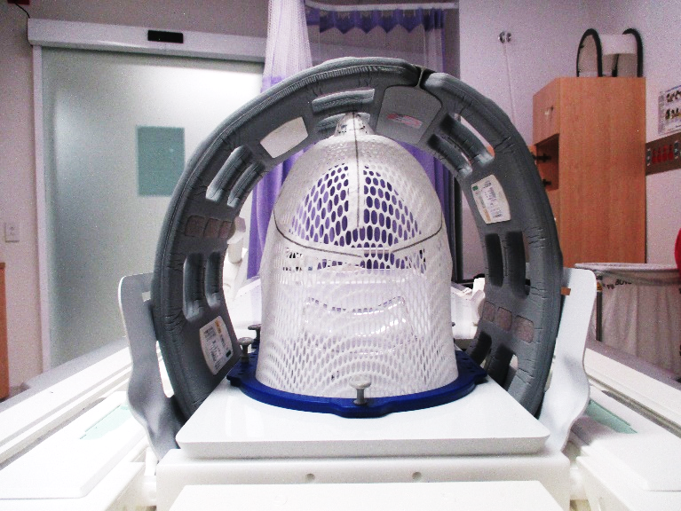
METHODS
Imaging
Pelvis
Brain

Slide 4
METHODS
Dosimetric Evaluation
Retrospective evaluation
CT gold-standard
  Eclipse planning system
  Accuros calculation model
Assessed:
  %DD at ICRU reference point
    (DsCT-DCT)/DCT * 100%
  Relevant DVH statistics
  3D Gamma
    3%/2mm
    2%/1mm
    1%/1mm

Slide 5
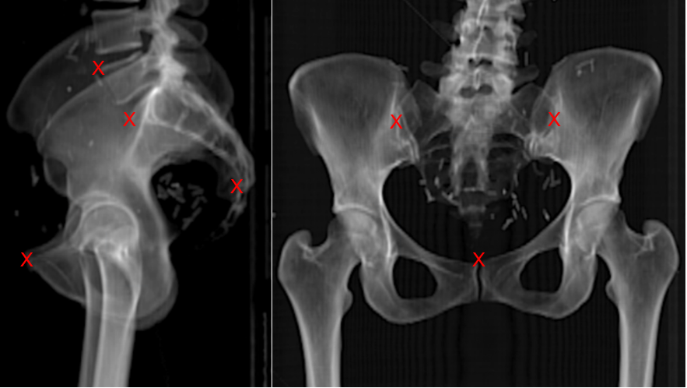
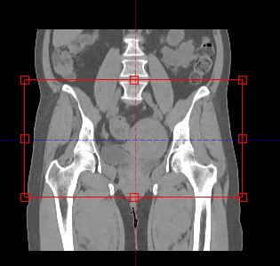
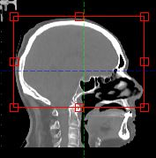
METHODS
Image Guidance Considerations
Auto-registration
DRR key matching points

Slide 6
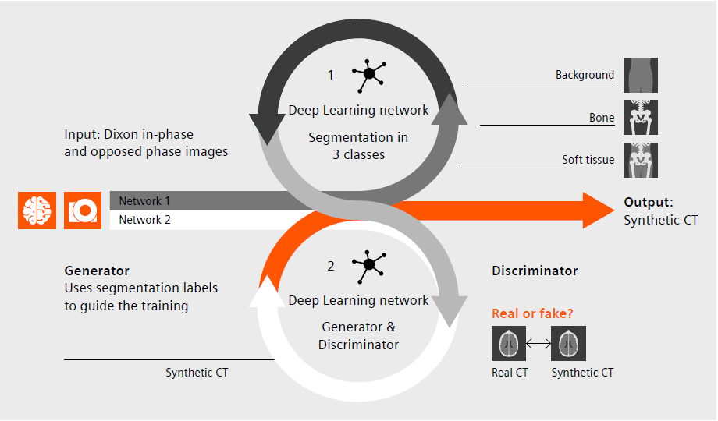
METHODS sCT Generation
Deep learning: cGAN
3 outputs:
  120kV equivalent
  Electron density
  Mass density
*Hoesl M, Escobar Corral N & Mistry N. White paper: MR-based Synthetic CT reimagined. Siemens Healthineers

Slide 7
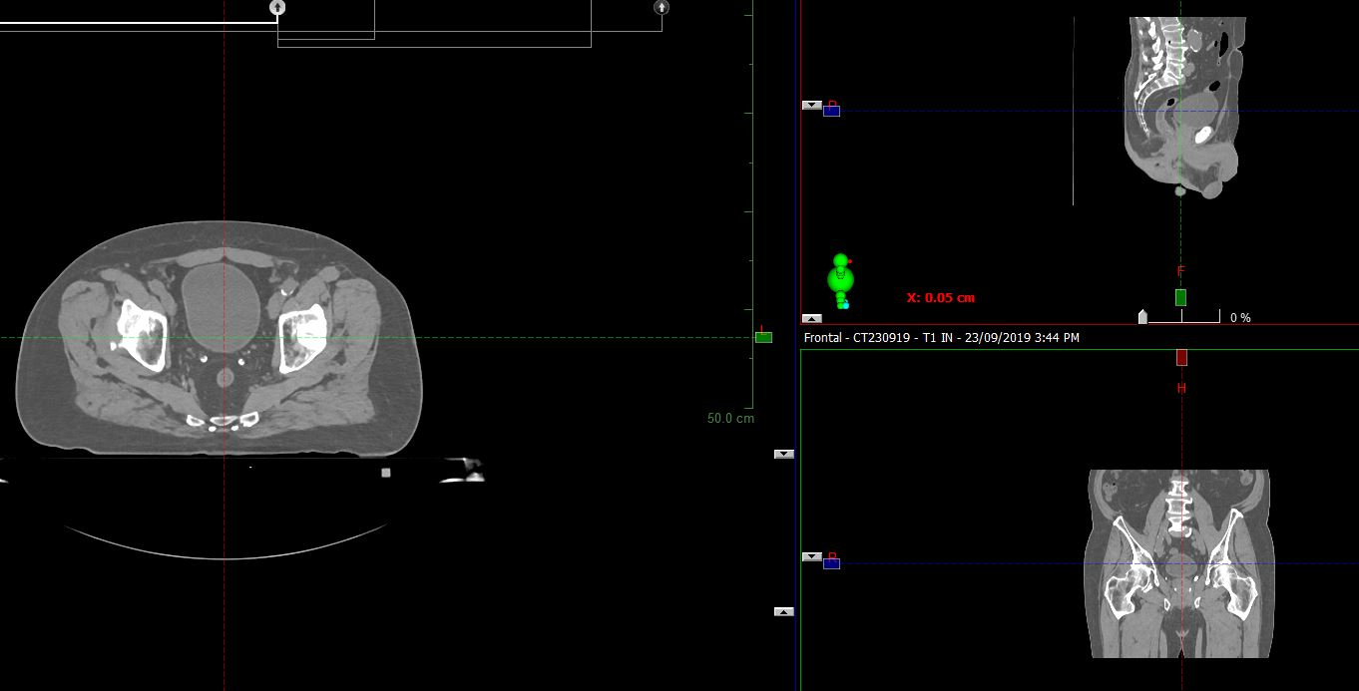
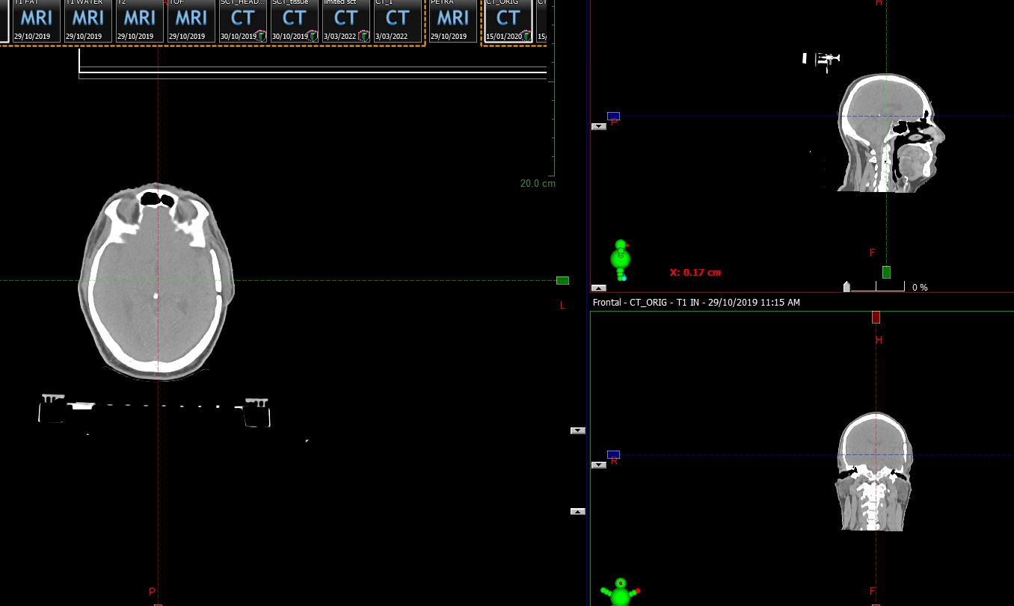
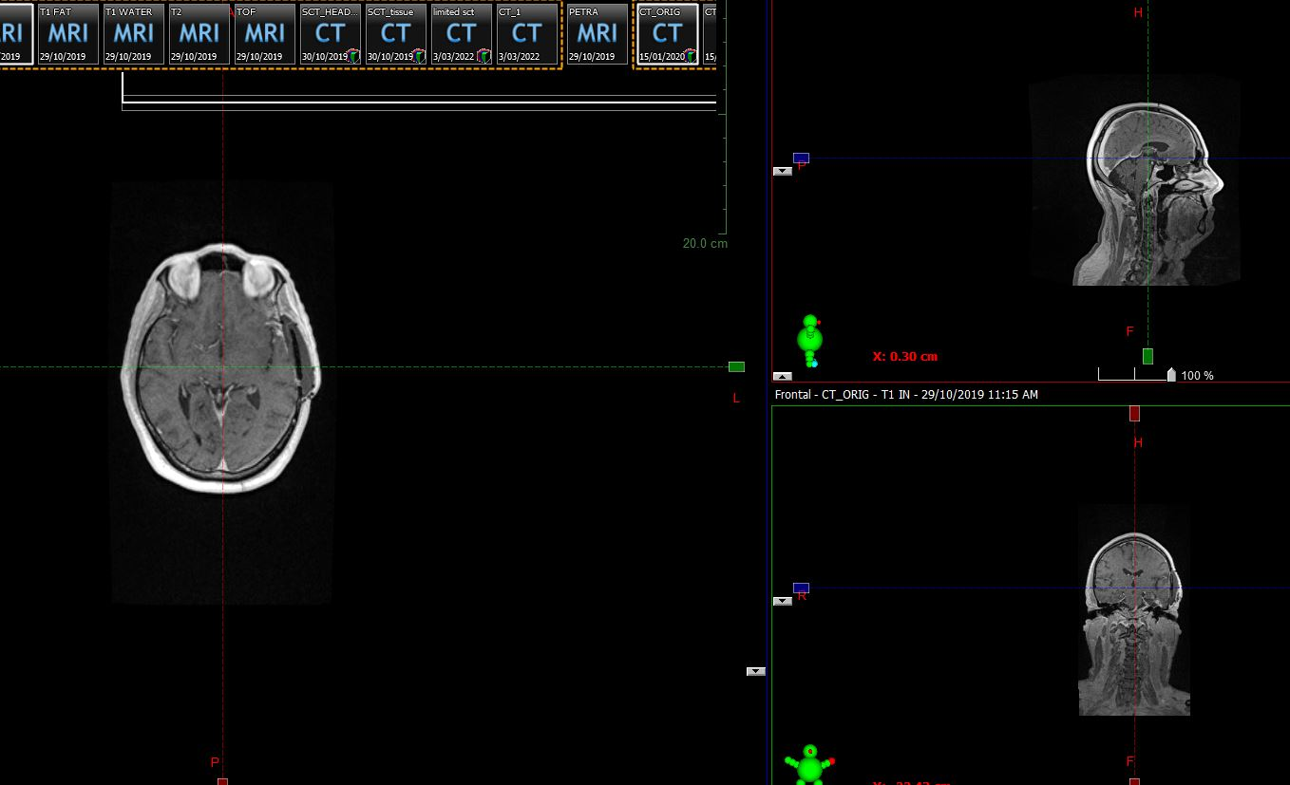
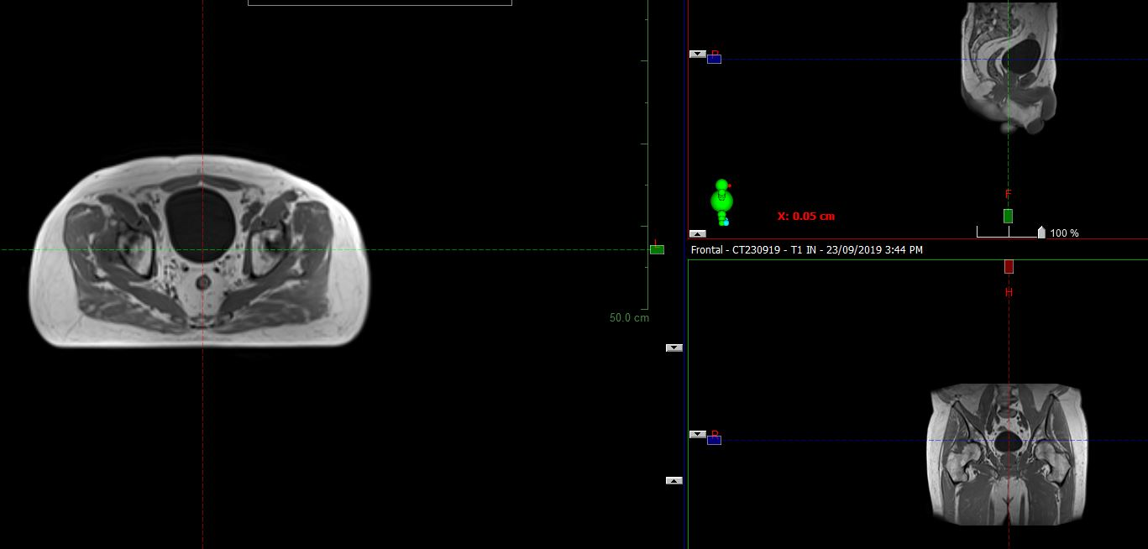
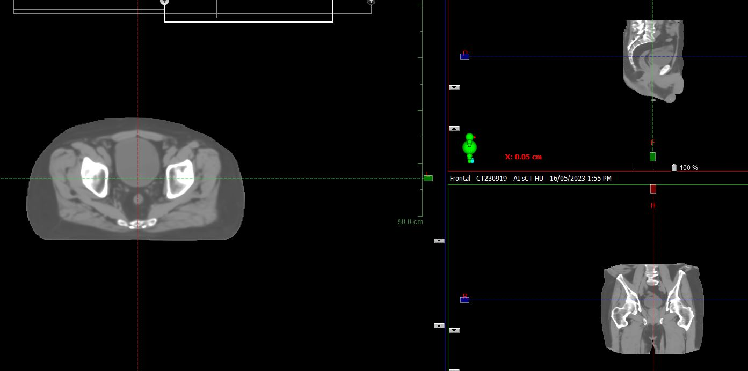
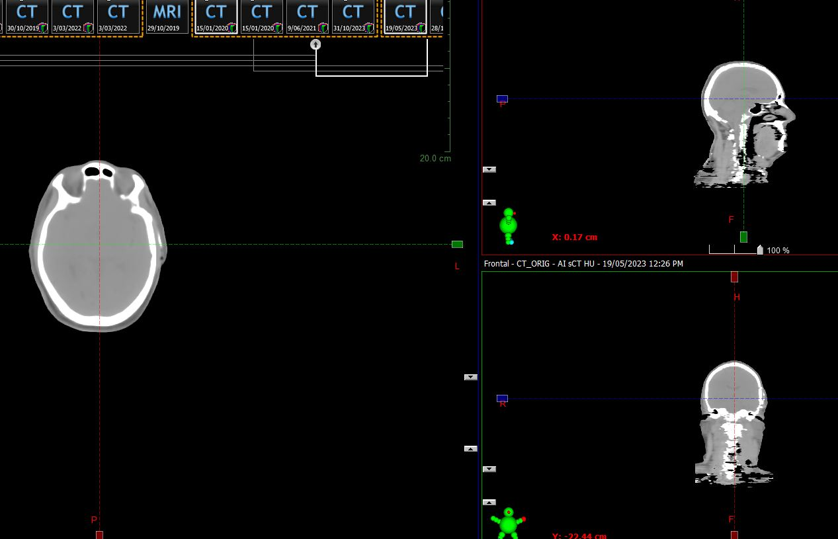
CT
T1 VIBE DIXON
sCT

Slide 8
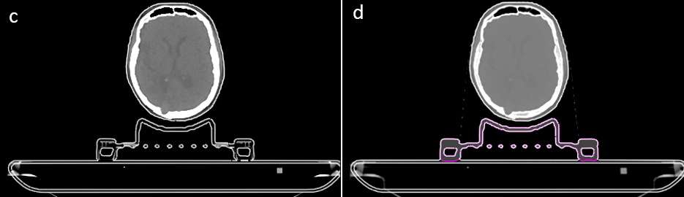
METHODS
Brain Bed Model

Slide 9
RESULTS
Pelvis
Dose Difference at ICRU
  AVE = 0.2% (SD 0.6)
  ABS AVE = 0.5% (SD 0.4)
DVH statistics
  AVE = 1.0% (SD 1.0)
3D Gamma
  3%/2mm = 99.98 (SD 0.04)
  2%/1mm = 99.78 (SD 0.24)
  1%/1mm = 96.62 (SD 2.56)

Slide 10
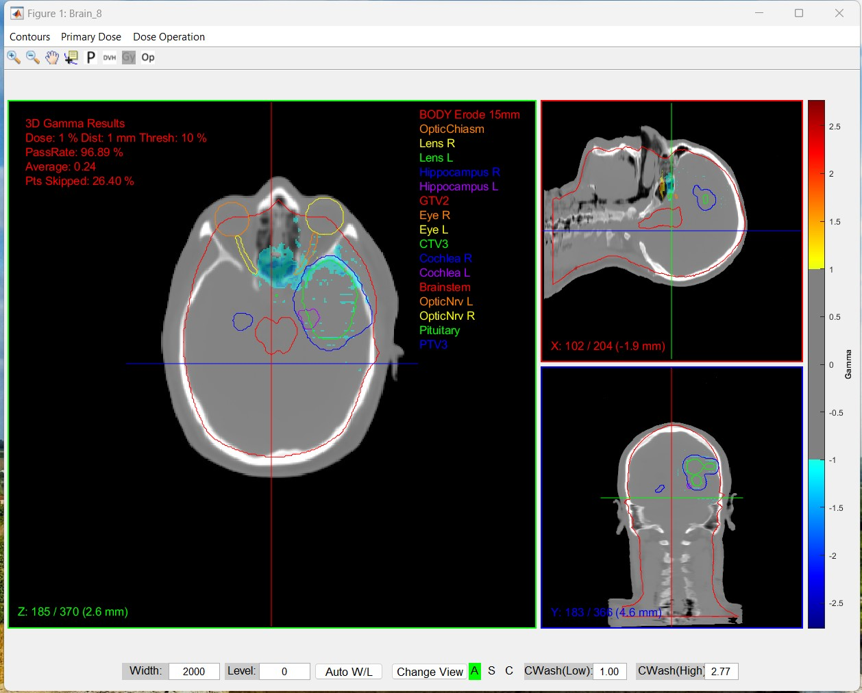
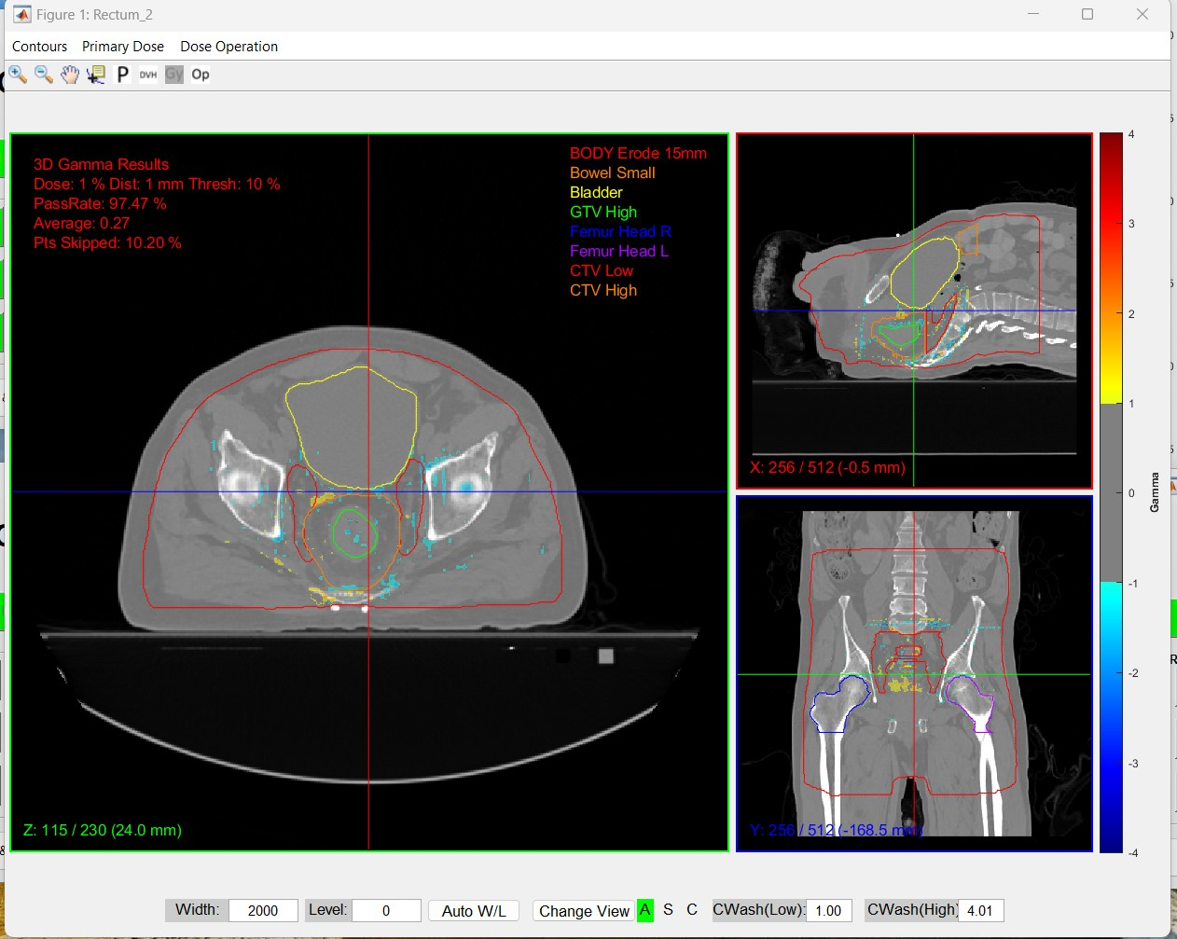
3D GAMMA
1%/1mm

Slide 11
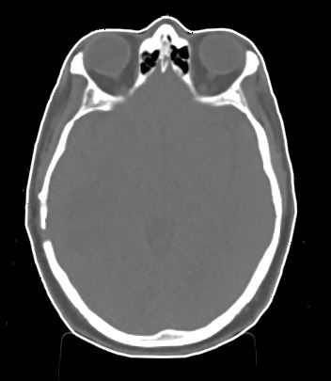
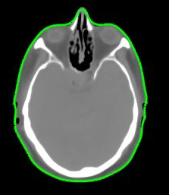
RESULTS
Brain
Dose Difference at ICRU
  AVE = 0.2% (SD 0.5)
  ABS AVE = 0.4% (SD 0.3)
DVH statistics
  AVE = 1.0% (SD 1.8)
3D Gamma
  3%/2mm = 99.79 (SD 0.19)
  2%/1mm = 97.99 (SD 1.53)
  1%/1mm = 92.06 (SD 4.97)
CT
sCT

Slide 12
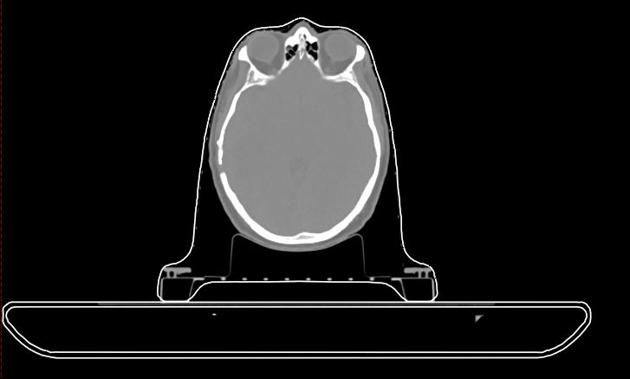
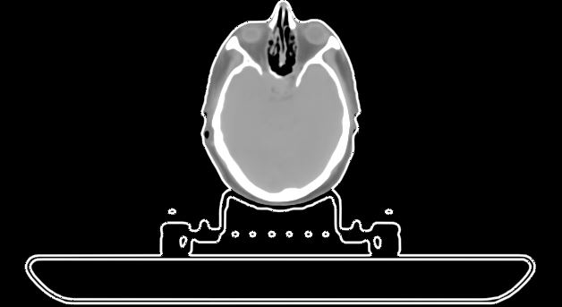
RESULTS
Brain
CT
Dose Difference at ICRU
  AVE = -0.4% (SD 0.7)
  ABS AVE = 0.7% (SD 0.5)
DVH statistics
  AVE = -0.7% (SD 2.1)
3D Gamma
  3%/2mm = 99.73 (SD 0.18)
  2%/1mm = 97.57 (SD 1.70)
  1%/1mm = 87.30 (SD 5.89
sCT

Slide 13
3D GAMMA
1%/1mm

Slide 14
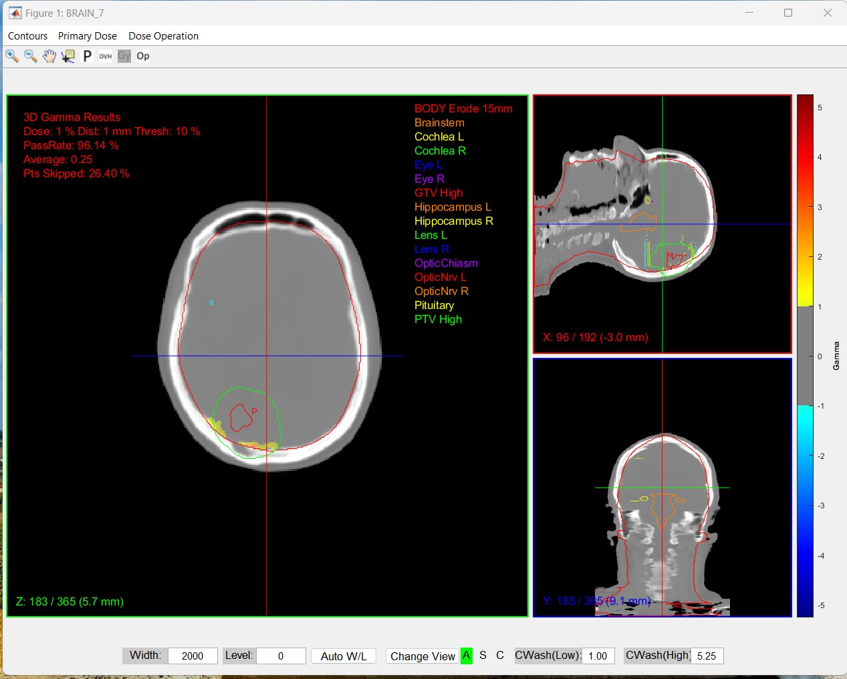
3D GAMMA
1%/1mm

Slide 15
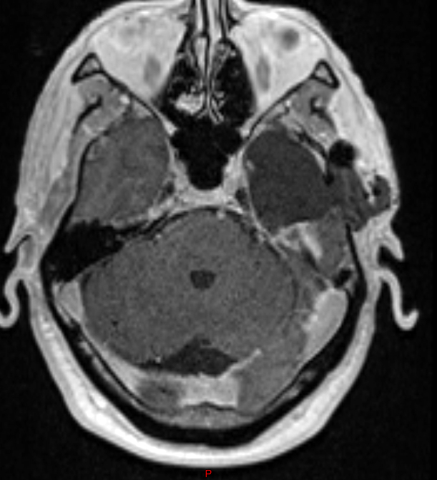
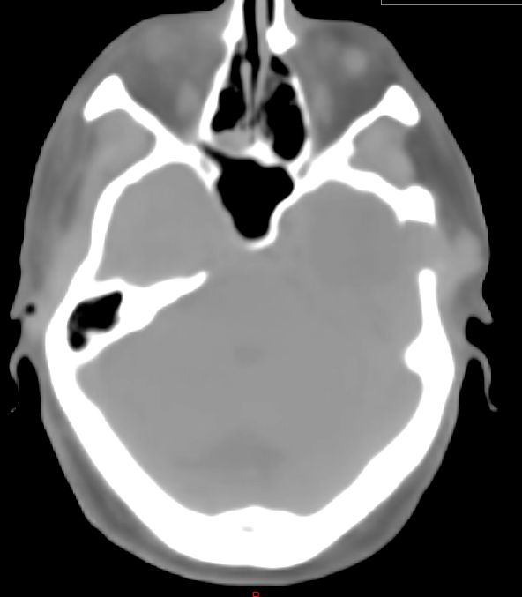
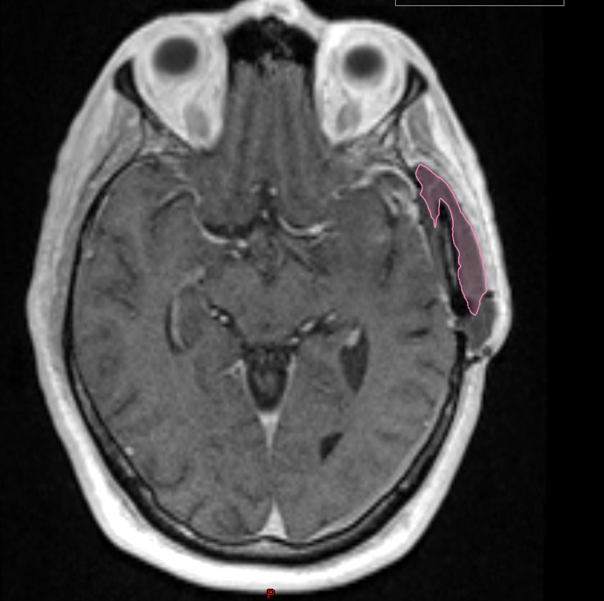
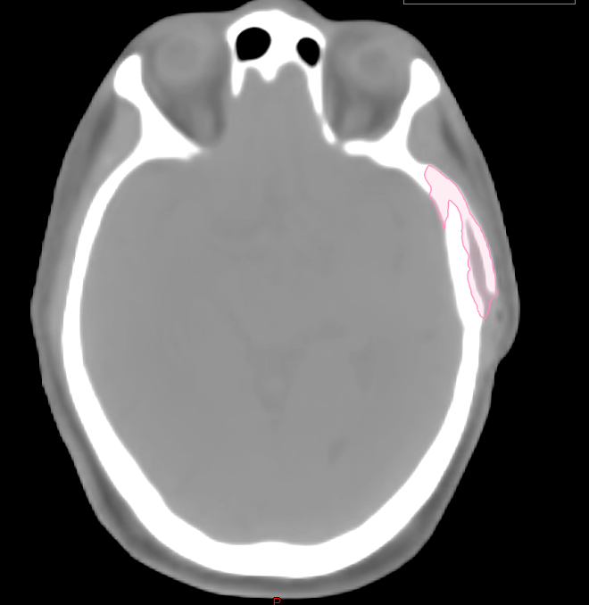
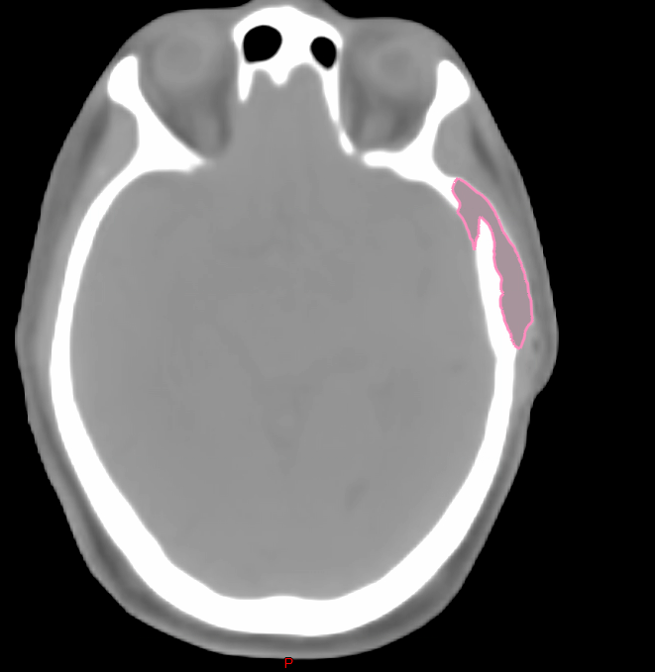
RESULTS
Brain - Bone

Slide 16
RESULTS
Image Guidance
 | x | y | z | pitch | roll | rot
Pelvis
Mean (mm) | 0.7 | 0.3 | 0.3 | 0.4 | 0.1 | 0.1
SD | 0.4 | 0.3 | 0.3 | 0.4 | 0.1 | 0.2
Brain
Mean (mm) | 0.13 | 0.29 | 0.31 | 0.19 | 0.14 | 0.11
SD | 0.13 | 0.16 | 0.49 | 0.14 | 0.13 | 0.10
 | Pubic sympysis |  |  | LT Sacro Iliac joint | RT Sacro Iliac joint | L5 Ant Vertebral body |  | Sacral/coccyx | Sup Sacrum
 | x | y | z | x | x | y | z | y | y | z
Mean (mm) | 1.0 | 1.1 | 1.0 | 1.2 | 1.3 | 1.7 | 2.2 | 1.6 | 2.5 | 1.6
stdev | 2.7 | 2.7 | 2.7 | 1.4 | 1.1 | 2.0 | 3.1 | 2.5 | 3.0 | 1.6

Slide 17
FUTURE APPLICATIONS
+Hyperarc Brain
+Pituitary and cranio-pharyngioma
01
+Utilize 18-channel ultra-flex coils
02
+Clinical Application
03
+CBCT - Mri image guidance
04

Slide 18
THANK YOU
Michaela Hoesl
Peter Greer
Claire Monk
Kate Skehan
Siemens Healthineers
Department of Radiation Oncology, Calvary Mater Hospital

