Slide 1
First Year Transition Program Parent Information Evening
Faculty of Science 21 February, 2018

Slide 2
Acknowledgement of Country
Before we begin the proceedings, I would like to acknowledge and pay respect to the traditional owners of the land on which we meet – (the Gadigal people of the Eora Nation). It is upon their ancestral lands that the University of Sydney is built. As we share our own knowledge, teaching, learning, and research practices within this University may we also pay respect to the knowledge embedded forever within the Aboriginal Custodianship of Country.

Slide 3
Welcome & Introductions
Professor Trevor Hambley
Dean of Science

Slide 4
What we know about student Transition to University Associate Professor John O’Byrne Associate Dean (Student Life)

Slide 5
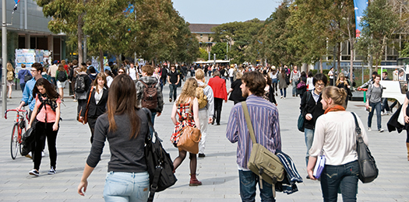
The BIG Change
Environment of the campus
“Its sooooo different to school”
“Its so much bigger than my school was”
“How am I going to find the rooms I’m supposed to be taking classes in?”
Notes:
Image from FASS

Slide 6
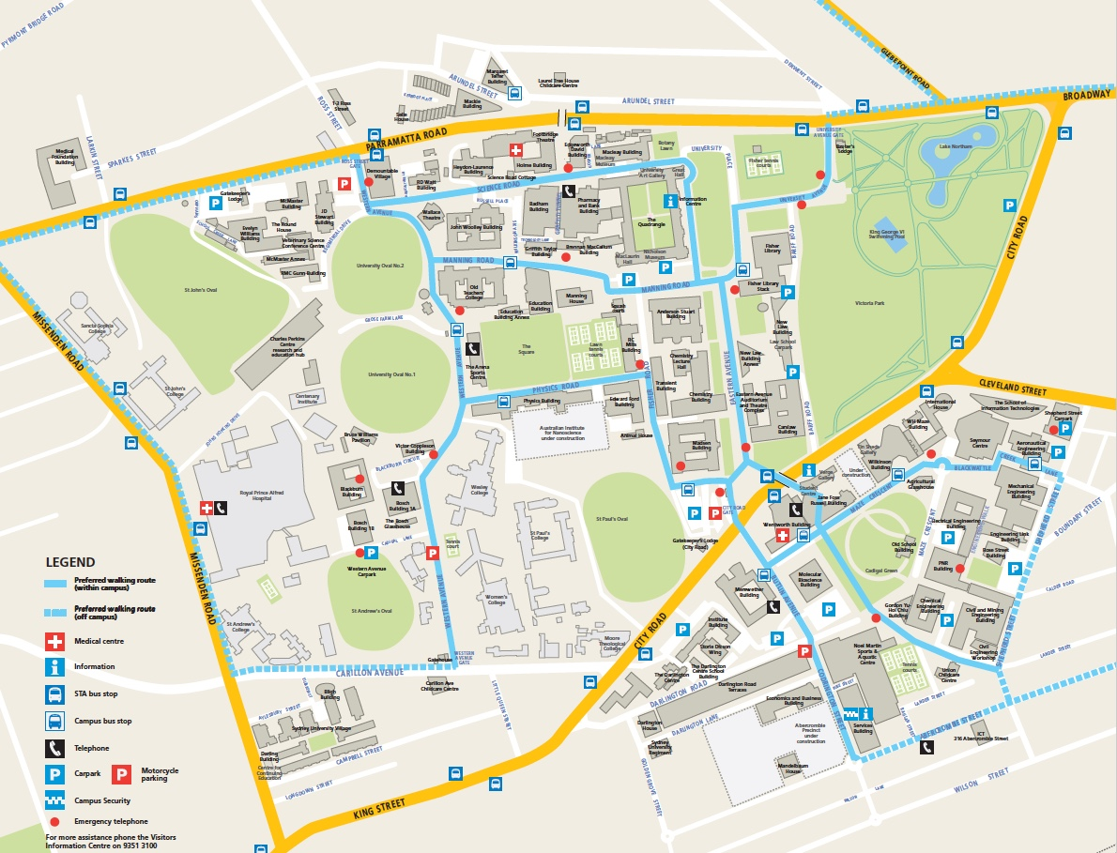
The BIG Change
Environment of the campus
“Its sooooo different to school”
“Its so much bigger than my school was”
“How am I going to find the rooms I’m supposed to be taking classes in?”
Loneliness
“My friends are in different courses at other universities…”
“in lectures there are so many people…I’m just another face in the crowd”
“I hate asking questions in lectures”
“None of the lecturers know who I am”
MAP – YU ARE HERE
Notes:
It s a suburb with its own postcode – and this is just the Main Campus
Areas enclosed by yellow is 2006 – Darlington is part of 2008
So hard to find a map – even this is not up to date
Find the rooms quickly enough – after the first week or two – except for exam rooms
Other campuses:
Camperdown/Darlington
Cumberland Campus
Camden Campus
Mallett Street Campus
Rozelle (Sydney College of the Arts)
Sydney Medical School Campuses and Teaching Hospitals
Surry Hills Campus
133 Castlereagh Street, CBD
Sydney Conservatorium of Music
Westmead
One Tree Island Research Station

Slide 7
The BIG Change
Environment of the campus
“Its sooooo different to school”
“Its so much bigger than my school was”
“How am I going to find the rooms I’m supposed to be taking classes in?”
Loneliness
“My friends are in different courses at other universities…”
“In lectures there are so many people…I’m just another face in the crowd”
“I hate asking questions in lectures”
“None of the lecturers know who I am”
Notes:
A consequence may be loneliness – lost in the crowd – it’s a big crowd
Quote some numbers
Most will get over this fairly quickly – it is important to have a social group

Slide 8
Faculty 2016
UG students 7500
1st year enrolments ???
PG coursework students 750
PG research students 1100
Academic staff 750
Professional staff 250
Faculty 2016
UG enrolments (total here=5872 -not all)
BSc 2527
MedSci 918
BLAS 916
AVBS 498
BSc (Hons) 252
BPsych 245
BVB/DVM 198
BFAB 162
BSc Ag 156
International UG EFTSL - Physics 10% of total, Chemistry 15%, Maths 22%
Faculty 2016
All Schools UG majority female except Physics 38%
e.g. Psyc 66%, Maths 54%
Faculty 2016
Diversity statistics - total 1925 from ~10k
Disability 575
Low SES 532
Regional 408
NESB 363
Indigenous 34
Uni 2016
Enrolments, total 64,326
Enrolments, international 20,811
Staff (full-time equivalent) 7527
Student:Staff ratio 17:3
Notes:
2016 numbers

Slide 9
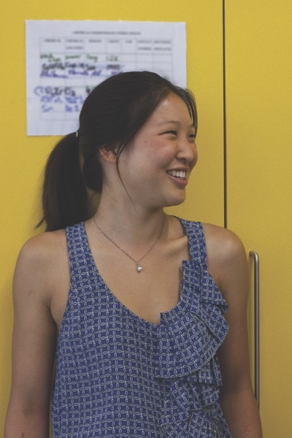
Other Issues Students Face
Teaching venues and style
Courses can be hard! (but interesting)
‘The system’
New curriculum
Notes:
Some people hate group work – but it is the reality of the world
Oh…..and by the way, courses can be hard!
The systems are changing – to improve the student experience – but it isn’t all perfect – or even close!
My experience enrolling Catherine
New curriculum is an opportunity (OLEs, projects, exchange) – but also a challenge – be nice to the staff trying to keep up

Slide 10
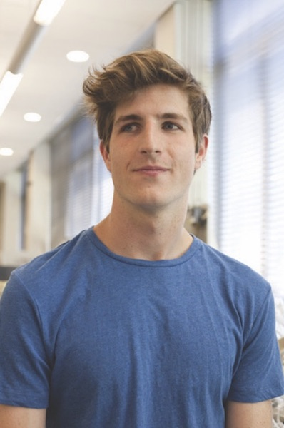
Other Issues Students Face
Teaching venues and style
Courses can be hard! (but interesting)
‘The system’
New curriculum
The REALLY hard issue for some students is taking personal responsibility
Motivation
Time management
Workload
Paid employment

Slide 11
10 Tips for First Year Students
Always go to class
Ask the lecturers and tutors questions
Use all the free help - academic and personal
Don’t copy other people’s work (and learn how to reference)
Learn how to use the libraries
Form a study group
7. Become more computer literate
8. Get involved in the social life of the campus
9. Plan your time for Uni, work and play
10. Make sure you get your work done…..and in on time!
Notes:
1 discuss
2 Most staff very willing to help – but time, uni systems can be problems – professional staff are excellent (many graduates themselves)
3 Maths Learning Centre, Learning Centre, CAPS, Disability Services, SRC
8 e.g. Science revue – talent is not necessarily a requirement

Slide 12
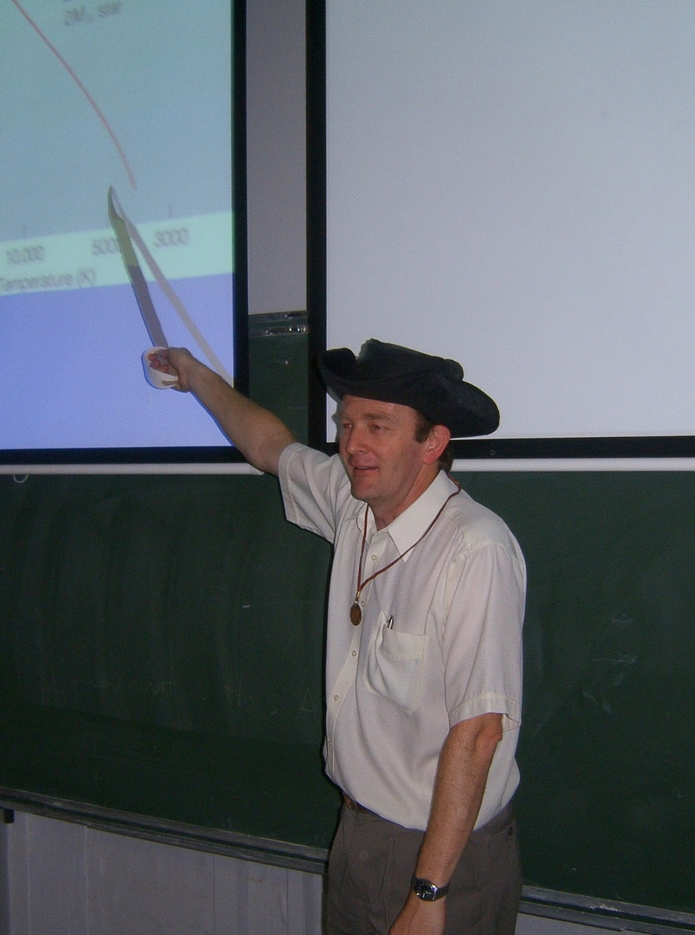
What you can do…
Encourage
Support
Listen
Be informed (but don’t know too much)
Probably do much that you have already been doing
Let them take responsibility
Notes:
You do what you have to – me on Talk like a pirate day (19/9) – also dress like one
The reality is that students don’t pass everything – Progression stage 1 ~4-500 in 2015, stage 2 ~200; stage 3 over 100

Slide 13
My Student Experience Jordan Martenstyn 3rd Year student, Bachelor of Science (Advanced)

Slide 14
My Student Experience Brittany Fossey Bachelor of Psychology (Honours)

Slide 15
Science Society Welcome Sarah Cutter-Russell Science Society (SciSoc) President

Slide 16
What on Earth is SciSoc?
(The University of Sydney Science Society)
Making friends

Slide 17
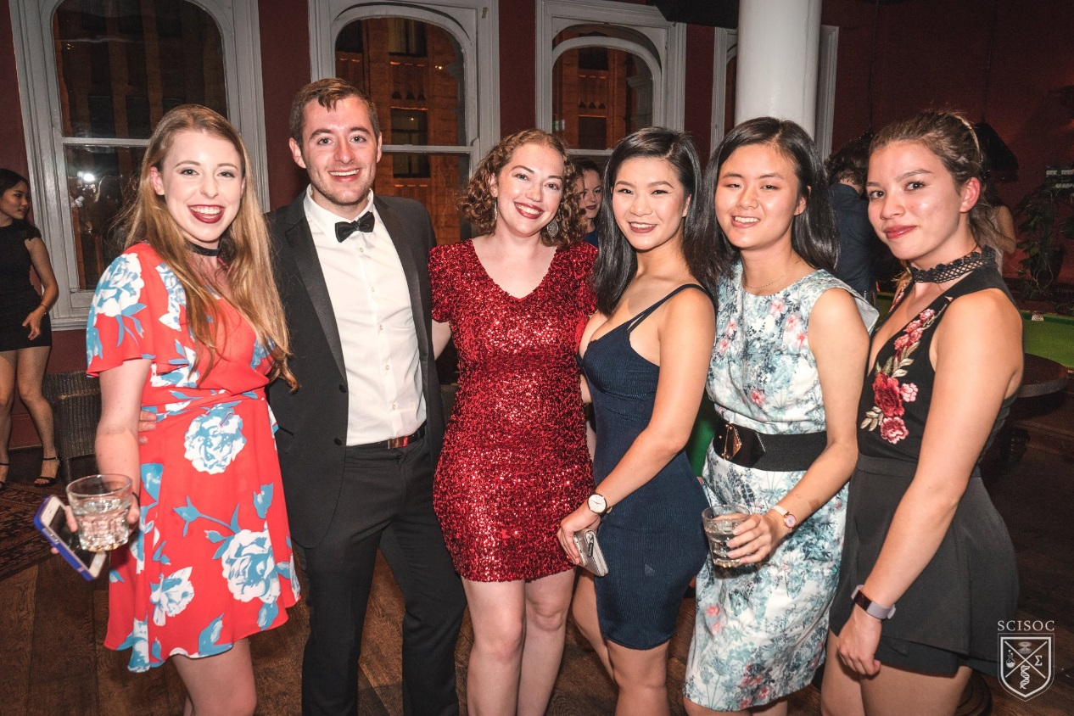
Friendships for Life

Slide 18
What on Earth is SciSoc?
(The University of Sydney Science Society)
Making friends
Work/life balance

Slide 19
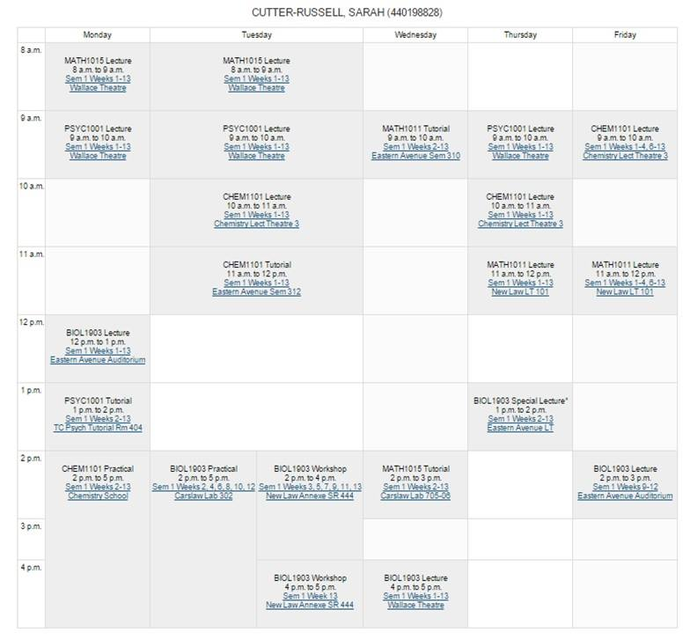
An Important Work/Life Balance

Slide 20
What on Earth is SciSoc?
(The University of Sydney Science Society)
Making friends
Work/life balance
Networking

Slide 21
It’s All About The People You Know

Slide 22
What on Earth is SciSoc?
(The University of Sydney Science Society)
Making friends
Work/life balance
Networking
Sense of belonging

Slide 23
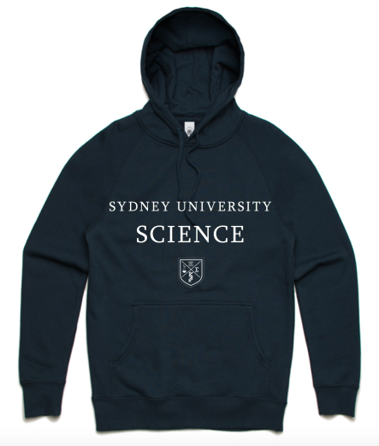
Being A USYD Science Student

Slide 24
What on Earth is SciSoc?
(The University of Sydney Science Society)
Making friends
Work/life balance
Networking
Sense of belonging
Leadership opportunities

Slide 25
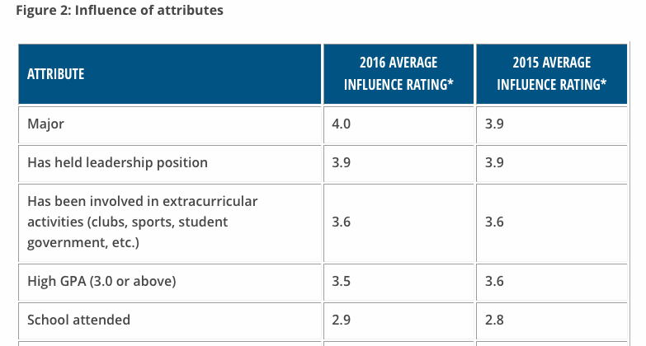
An Opportunity for Leadership
Source: Job Outlook 2016, National Association of Colleges and Employers

Slide 26
What on Earth is SciSoc?
(The University of Sydney Science Society)
Making friends
Work/life balance
Networking
Sense of belonging
Leadership opportunities
Having fun

Slide 27
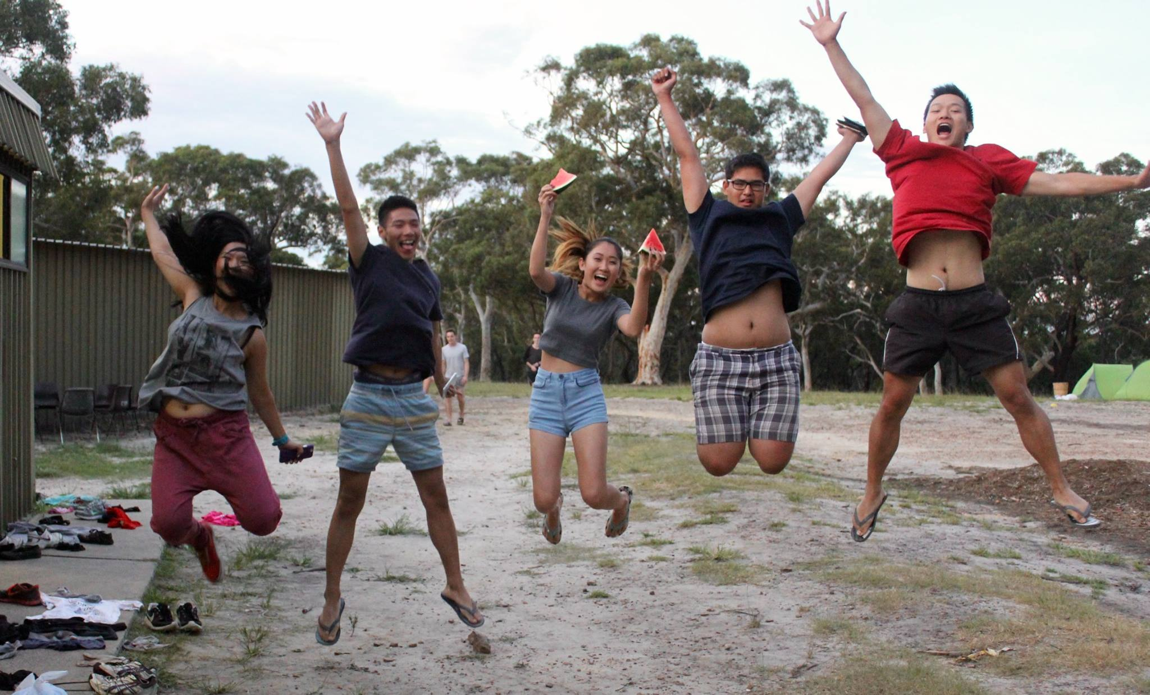
Uni Should Be FUN!

Slide 28
What on Earth is SciSoc?
(The University of Sydney Science Society)
Making friends
Work/life balance
Networking
Sense of belonging
Leadership opportunities
Having fun

Slide 29
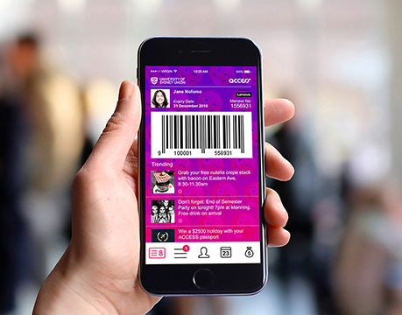
The Bigger Picture
1 of 200+ Societies
OWeek & Transition Workshop
ACCESS Membership

Slide 30
Contact/Follow Us
Facebook: www.facebook.com/scisocusyd
or search for scisocusyd
Instagram: @scisocusyd
Email: usydscisoc@gmail.com
Thank You! ☺

Slide 31
Careers following a Science based training Jessie Alchin Manager, Student Experience Bachelor of Science

Slide 32
There is a common misconception
A typical Science Graduate
A typical Career
Notes:
Science graduates work in many different roles in many different industries.
International research indicates that 75% of the fastest growing occupations now require STEM skills and knowledge.

Slide 33
Who employs science graduates
Mining/Resources | Agriculture, Forestry and Fisheries
Medical-related industries | Psychology
Veterinary and Animal Industries | Health and Community
Research | Sport-related industries
Finance, Banking and Insurance | Water-related industries
Business, Management & Consultancy | Astronomy
Media, Marketing and Communications | Tomorrow’s Technologies
Education and Training | Biotechnology
IT, Communications and Technology | NGOs / International Development
Sustainability-related industries | Materials-related industries
Government, Defence and Legal sectors | Conservation
Notes:
These are just some of the current employers of science graduates, but where will future graduates end up?

Slide 34
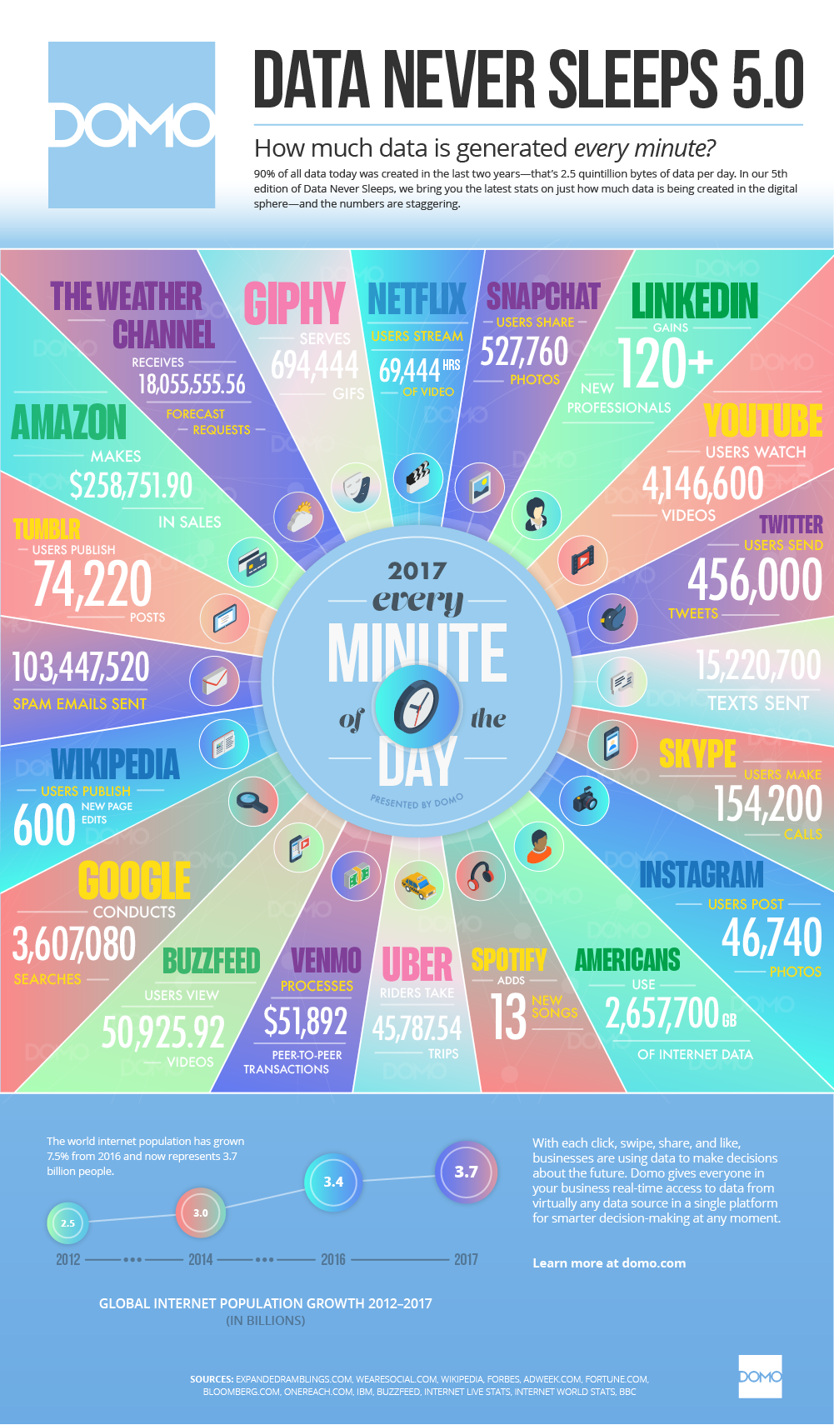
How much data is generated every MINUTE
Source: domo.com
Notes:
Over the past decade, we have experienced a digital communications revolution. The speed of the change is unprecedented: it took radio 38 years to attract an audience of 50 million people; television took 13 years, while the internet took three years.
A suite of new digital technologies, such as machine learning, optimisation, artificial intelligence, sensing, robotics, visualisation and distributed ledgers, are opening new opportunities for innovation.
These new technologies mean we exist in a data driven world. Every minute of every day, data is being collected – with every click on a computer, every tap of the opal card, every time we open google or facebook or Instagram. Every experiment we run in labs for scientific or medical research. We have drones and robots collecting information on farms, in production. Huge data is being collected and it is increasingly important that we have a workforce who are able to look at this data and pull information from this to inform and project trends and behaviours. Increasingly, we have industry approaching us because they have realised that the value in the skills of a STEM graduate who are trained to take this data and turn it into something of value

Slide 35
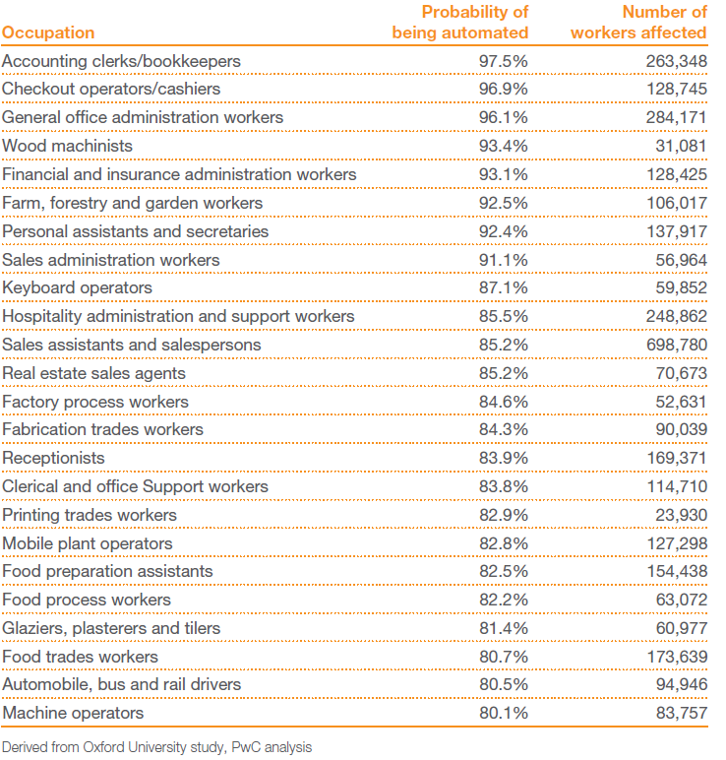
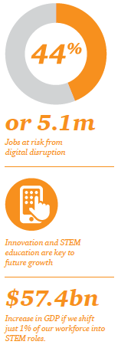
Notes:
The world as we know it is changing – digital disruption and automation will increasingly affect our workforce in the kinds of jobs that are available, and the skills required to complete them. The current misconception is that automation will replace the need for a human workforce however it is rarely acknowledged that these new technologies will create new jobs – jobs that will demand a different kind of skill to do them: STEM skills.
Modelling shows that the jobs most likely to endure over the next couple of decades are ones that require high levels of social intelligence, technical ability and creative intelligence.
But what about the jobs we don’t yet know we need, the jobs of the future? The rapidly changing nature of technology and global competition makes it difficult to predict precisely what these will be. Facebook, Uber, Air BNB, Spotify – 15 years ago, we had no idea what these were and could never have predicted how big these would become.
What we do know, however, is that technology and innovation, which are transforming our economy whether we like it or not, are key to solving both our workforce and our growth challenge. In order to realise our potential, Australia needs a workforce that is technologically savvy and able to innovate. And one of the best ways to do this is employing a workforce with capabilities in STEM.
Data from a recent SEEK Employment report indicates that there is an increased demand nationally and internationally for STEM skills. Australian CEOs have already identified the “talent shortage: or STEM skills as one of their top business risk areas. It is critical to Australia’s prosperity that we are generating interest in and producing students in STEM disciplines.
Ninety-two per cent of future jobs will require some form of digital skills, making digital literacy an essential foundation workforce skill, in the same league as basic literacy and numeracy today. Australia’s employment mix is also changing to require and favour a higher quotient of STEM jobs and skills. Occupations currently requiring STEM skills are outstripping overall employment growth

Slide 36
Need for STEM Graduates
Modelling by PwC shows that if Australia were to develop a STEM workforce in line with other leading STEM countries, it would generate, in present value terms, an additional $54.7 billion in GDP over the next 20yrs
Between 2012 and 2015, digital skills were the fastest growing skill set sought by Australian employers in early-career roles (growing at 212 per cent per year), alongside critical thinking (158 per cent), creativity (65 per cent) and presentation skills (25 per cent)
PwC, Millennials at work: Reshaping the workplace, www.pwc.com/people
Notes:
Like other developed countries, Australia faces a shortage of full-time workers if we want to maintain per capita GDP at current levels – with a gap of 6 per cent projected by 2030 (Figure 4).18 Although labour productivity will provide some continuing growth, at current rates it will not make up the shortfall in labour growth from retirement.
How well we use digital technology will be critical. Digital technology increases the productivity of existing practices and creates new domestic and export markets and services that expand growth. Greater adoption of digital technology could increase Australia’s annual GDP growth rate by 0.7–1.2 per cent.
A workforce equipped with STEM skills will be positive for the economy, and are essential to fill the workforce gap left by demographic change, to lift productivity and contribute to GDP growth.

Slide 37
Encourage Career Thinking
Join campus-based clubs and societies
Join industry bodies, professional organisations
Read relevant websites, newspapers, industry journals
Write for student publications
Talk to academics, visiting organisations, employers
Attend workshops, conferences, guest presentations
Apply for relevant work experience and research projects
Enter university or industry-based challenges and competitions
Become a mentor
Plan toward Honours year and postgraduate study
Notes:
We really want our students to start thinking about their careers when they commence their University studies. They don’t need to know exactly where they want to be in three or five years, but it is important to start exploring what their options are.

Slide 38
Current Student Programs
Jumpstart Your Science Career- Week 6 Semester 1 Industry speakers/ representatives and recent graduates Networking opportunity + ‘matchmaking’
Careers Centre Workshops and events
Science specific workshops such as resume writing, interview skills
Peer Mentoring Program and Dalyell
Integrated into Mentoring Program and Dalyell Scholars program. Examples include workshops and consultations with researchers and lab tours
Notes:
We have career focused and mentor programs to help our students on their path to a successful career.

Slide 39
Faculty of Science Student Experience
facebook.com/SydneyScienceStudents/
Notes:
On our Student Experience facebook page we highlight upcoming opportunities for current students.

Slide 40
International Opportunities
We have over 270 international programs including:
Student Exchange
Study Abroad
Short-Term Study
Field Trip Units
School of Geography, Geology and Geophysics
Faculty Run Programs
Short term research opportunities (4-6 weeks)
Summer School
Notes:
The University of Sydney offers over 270 international programs. We have a number of exchange and study abroad agreements with a number of top international institutions such as the University of California (including Berkely, Davis and San Diego), the University of Copenhagen, University of Edingburgh, Hong Kong and Peking University. In addition, there are short term study abroad programs with Harvard University, University of Alberta and UCLA.
The School of Life and Environmental Sciences and the School of Geosciences regularly run units of study with a field trip component. Deopending on your major, some students will have the opportunity to travel across Australia or internationally as part of that – for example we currently have a group of 10 geoscience students that are on a Field School in India.
The Faculty also runs its own programs for example short term research exchange opportunities – we run a Nanjing Exchange Program where students travel to China to work with an academic from Nanjing Univeristy. Just recently, we ran a joint-Summer School around Food and Health with Padova University in Italy

Slide 41
Other Opportunities
Volunteer- Mentor leader, Student Ambassador, Australian Indigenous Mentoring Experience (AIME) Program
Clubs and Societies - leadership opportunities, collaborative work
Overseas Exchange - study abroad
Casual work - internal and external, find out through Careers Centre email update
Internships and Scholarships- including Summer Research Scholarship, Undergraduate Exchange Scholarships and Chemistry’s Year in Industry Program
Careers Fairs, Workshops & Industry ad hoc events

Slide 42
Ways for parents to get involved
Facebook – Faculty of Science
@SydneyScience
Twitter
@sydney_science
Instagram sydney_science
The University of Sydney
Page 37
Notes:
You can also connect with us on facebook, instragram and twitter

Slide 44
Q&A Panel
Christie McMonigal
Science Alumnus (Bachelor of Science (Honours))
Ms Helen Agus
Associate Dean (Student Affairs)
A/Prof John O’Byrne
Associate Dean (Education)

Slide 45
Thank you
Please join us for some light refreshments in the foyer

